Slide 1






Portfolio #4
Computer Hardware & Software:
THEIR IMPLEMENTATION IN THE DIFFERENT INSTITUTIONS IN THE COMMUNITY

Slide 2






What is a Computer?

Slide 3




Computers
A Computer is an electronic device that accepts user input (data) and processes it under the influence of a set of instructions referred to as programs to produce the desired output generally referred to as information (Mugivane, 2014).

Slide 4






Basic Functionalities of Computers:
INPUTS
PROCESS
OUTPUTS
STORAGE
Processes the data and converts it into useful information for the computer to use.
Once inputs have been processed, and now are ready to be presented to the user, the information will be outputted to the user.
Stores the data/instructions in its memory and use them when required.
These are data given to the computer system from a user.

Slide 5


Parts of a Computer!
A computer must have all of the different components that enables a computer to take input, process data, present outputs, and store information.
HARDWARE & SOFTWARE

Slide 6


COMPUTER HARDWARE
The Computer Hardware is a component of a computer system that which provides the physical mechanisms to input and output data, to manipulate and process data, and to electronically control the various input, output, and storage components (Englander, 2010).

Slide 7
Types of Computer Hardware:
INTERNAL
Internal Computer Hardware are the primary parts of a component that affects its performance and functionality. These are components that are necessary for a computer to function.
EXTERNAL
External Computer Hardware or Peripherals are devices connected to computers to enhance its usability and expand its functions.

Slide 8

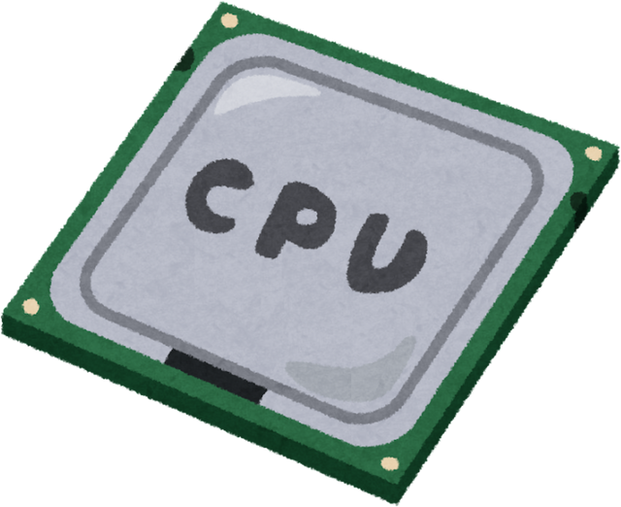
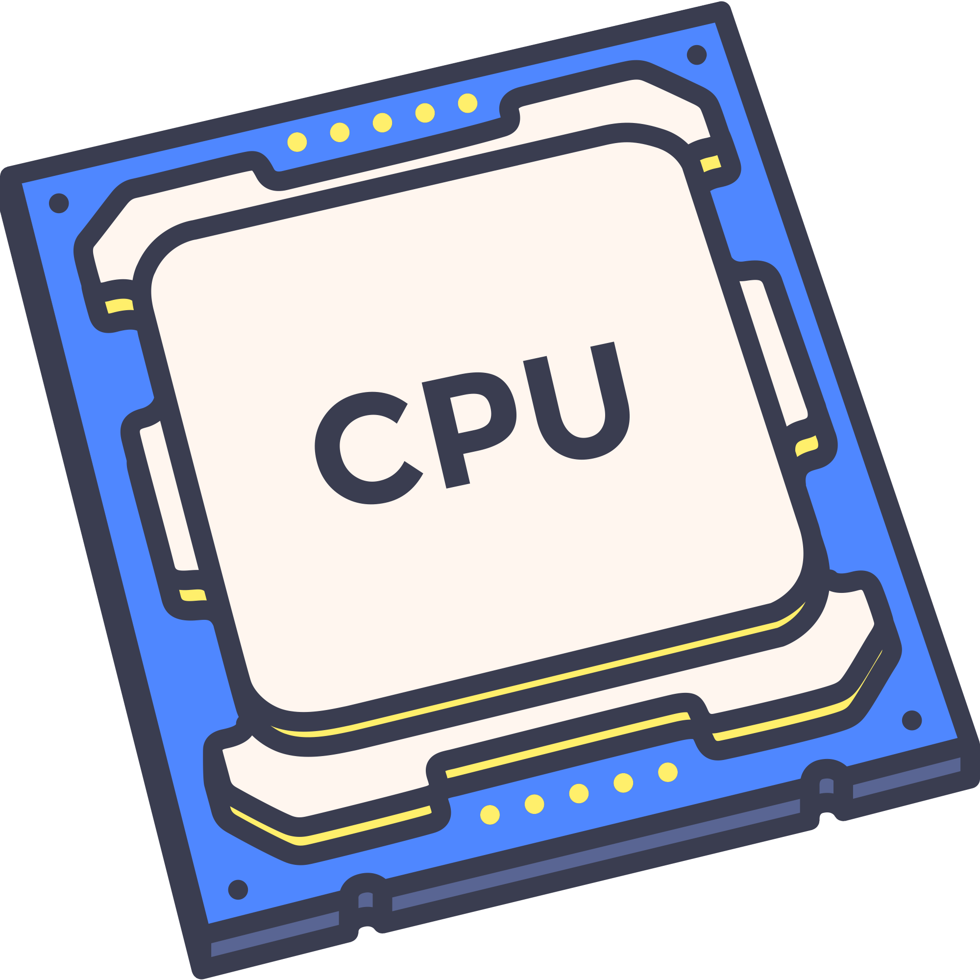
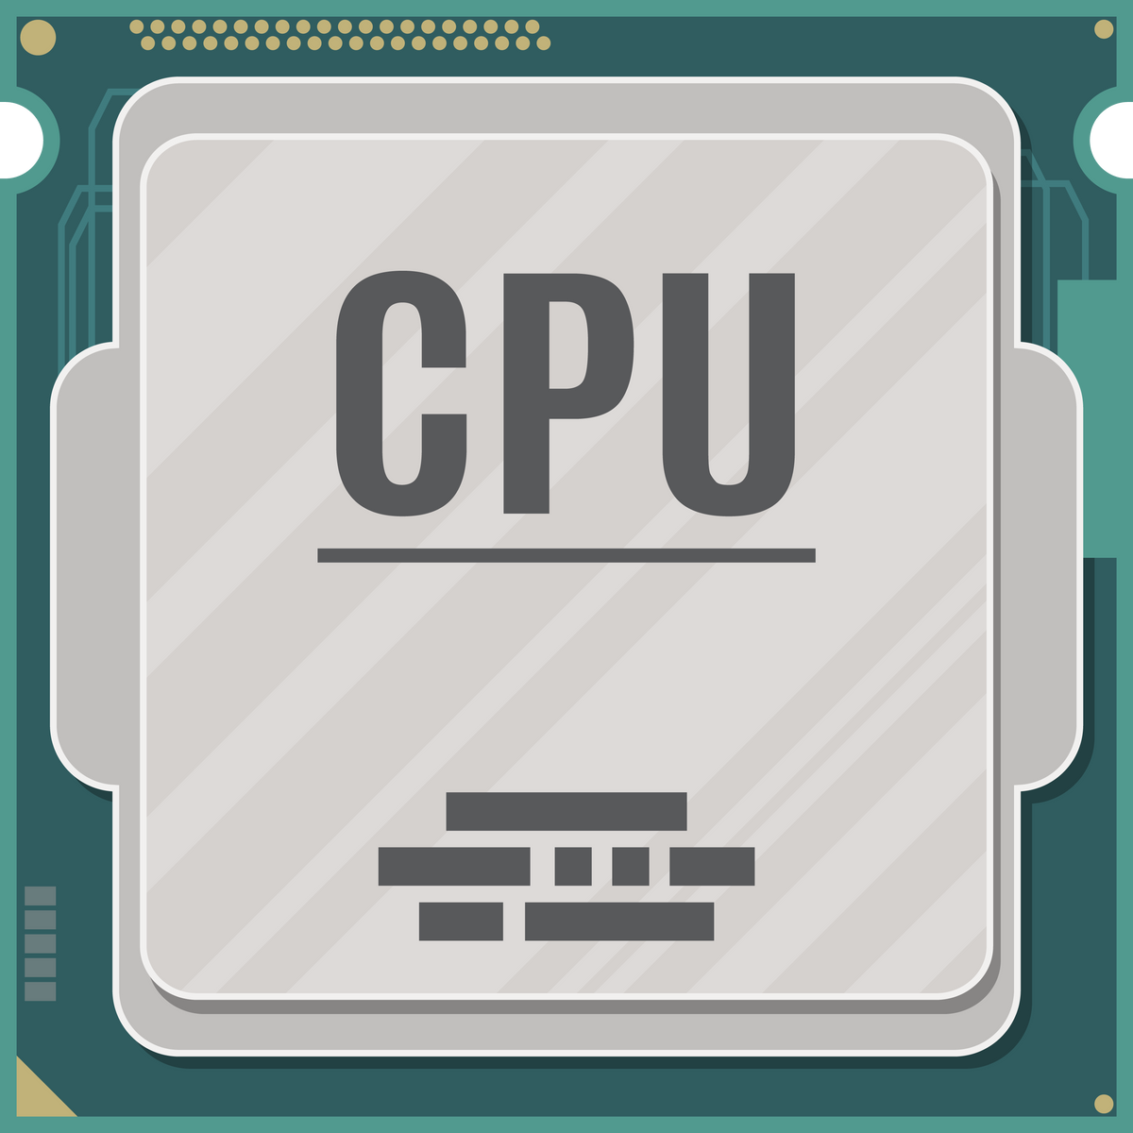
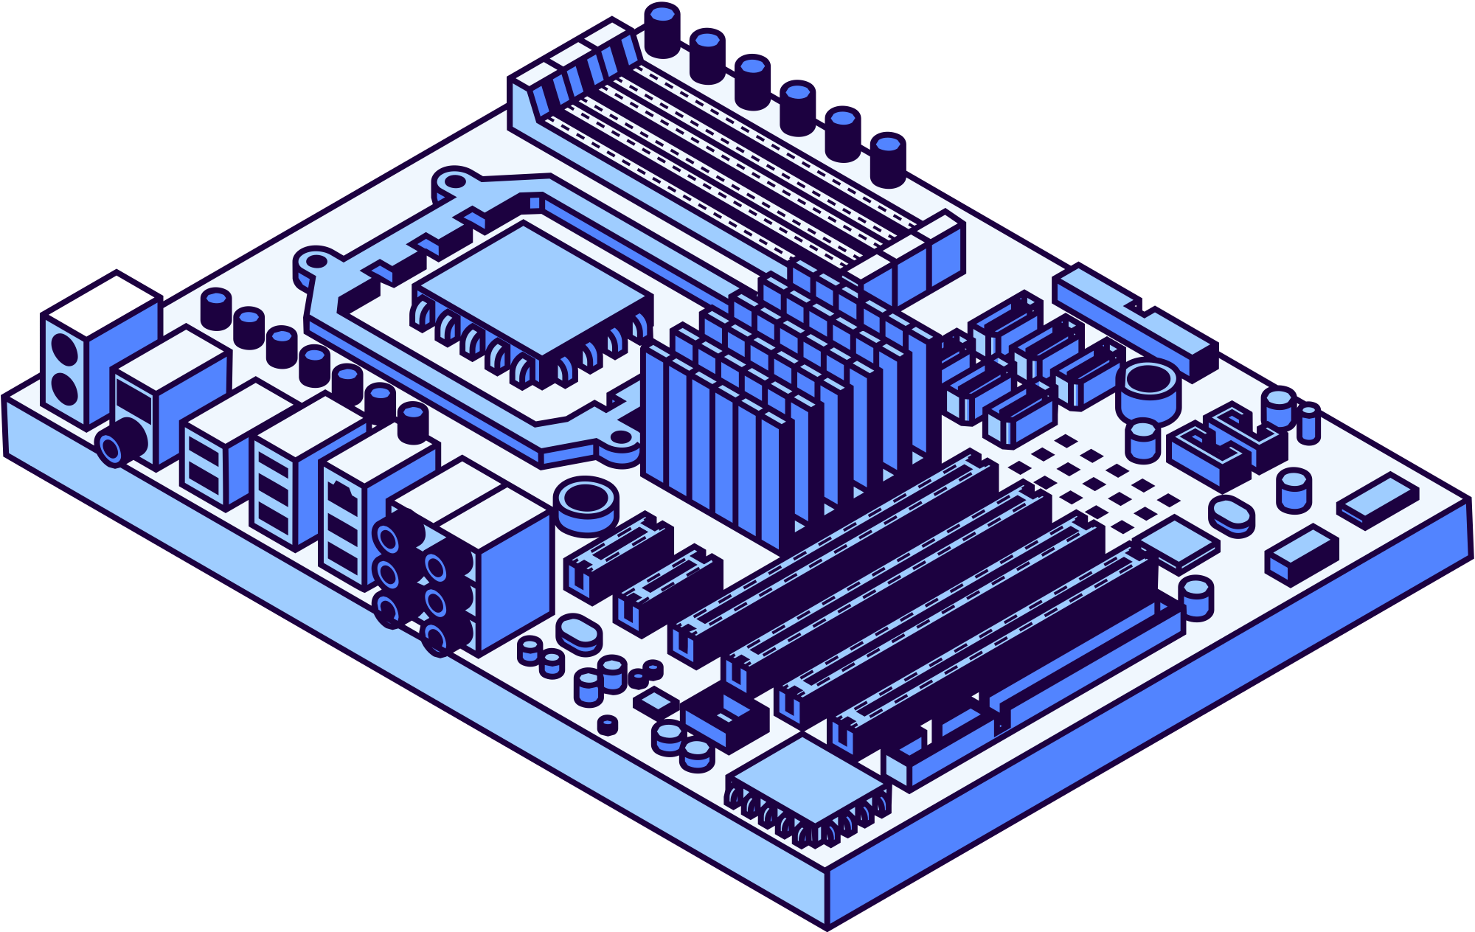
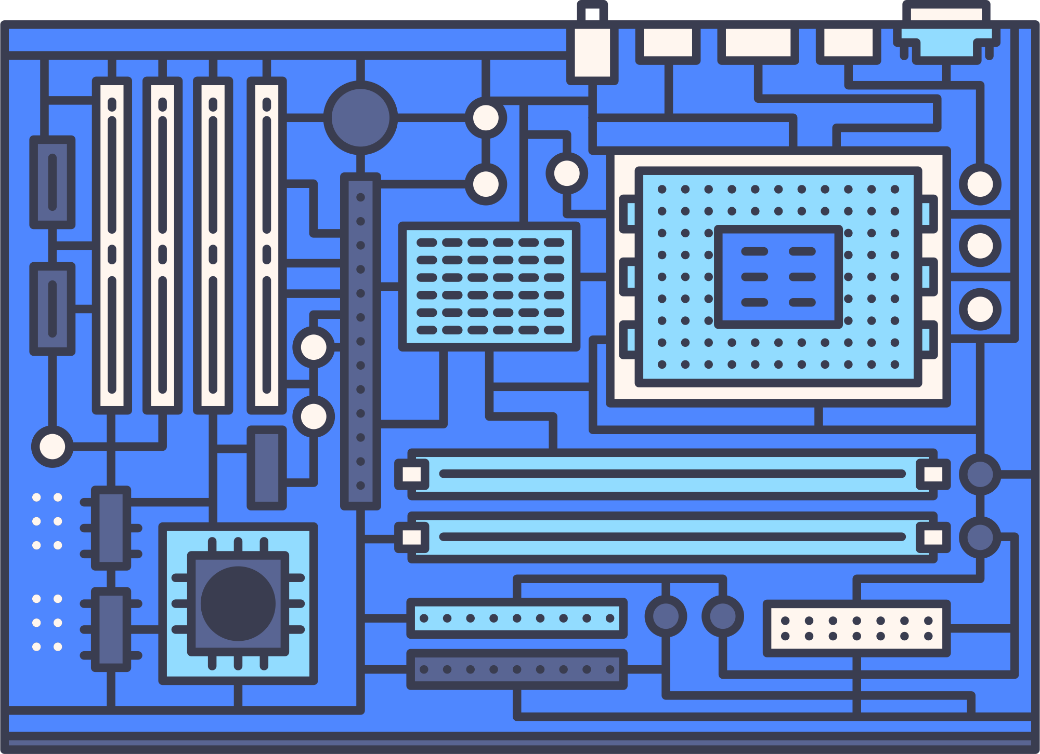
Examples of Internal Computer Hardwares:
Source: PC Components
PROCESSOR (CPU)
MOTHERBOARD
The processor’s function is to control the activities of the computer system. A computer program is made up of instructions and when the program is run, the processor is responsible for carrying out these instructions in an orderly fashion.
Often called the mainboard or system board, it is the main circuit board for the computer system. Every device in the computer system will either be part of the motherboard or connected to it.

Slide 9

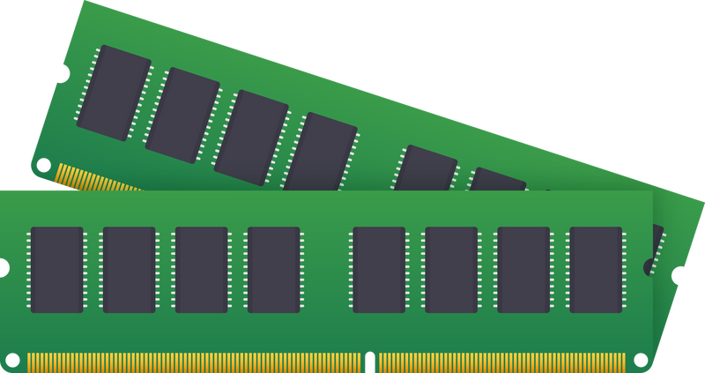
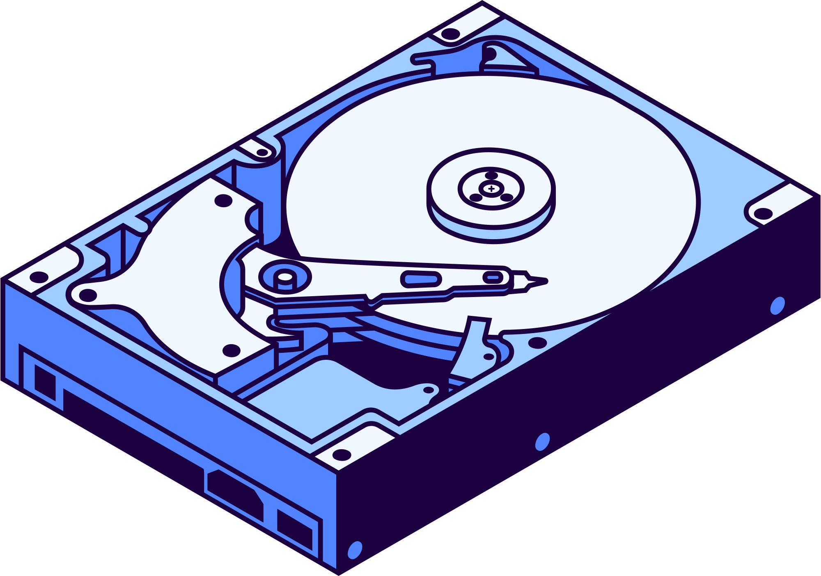
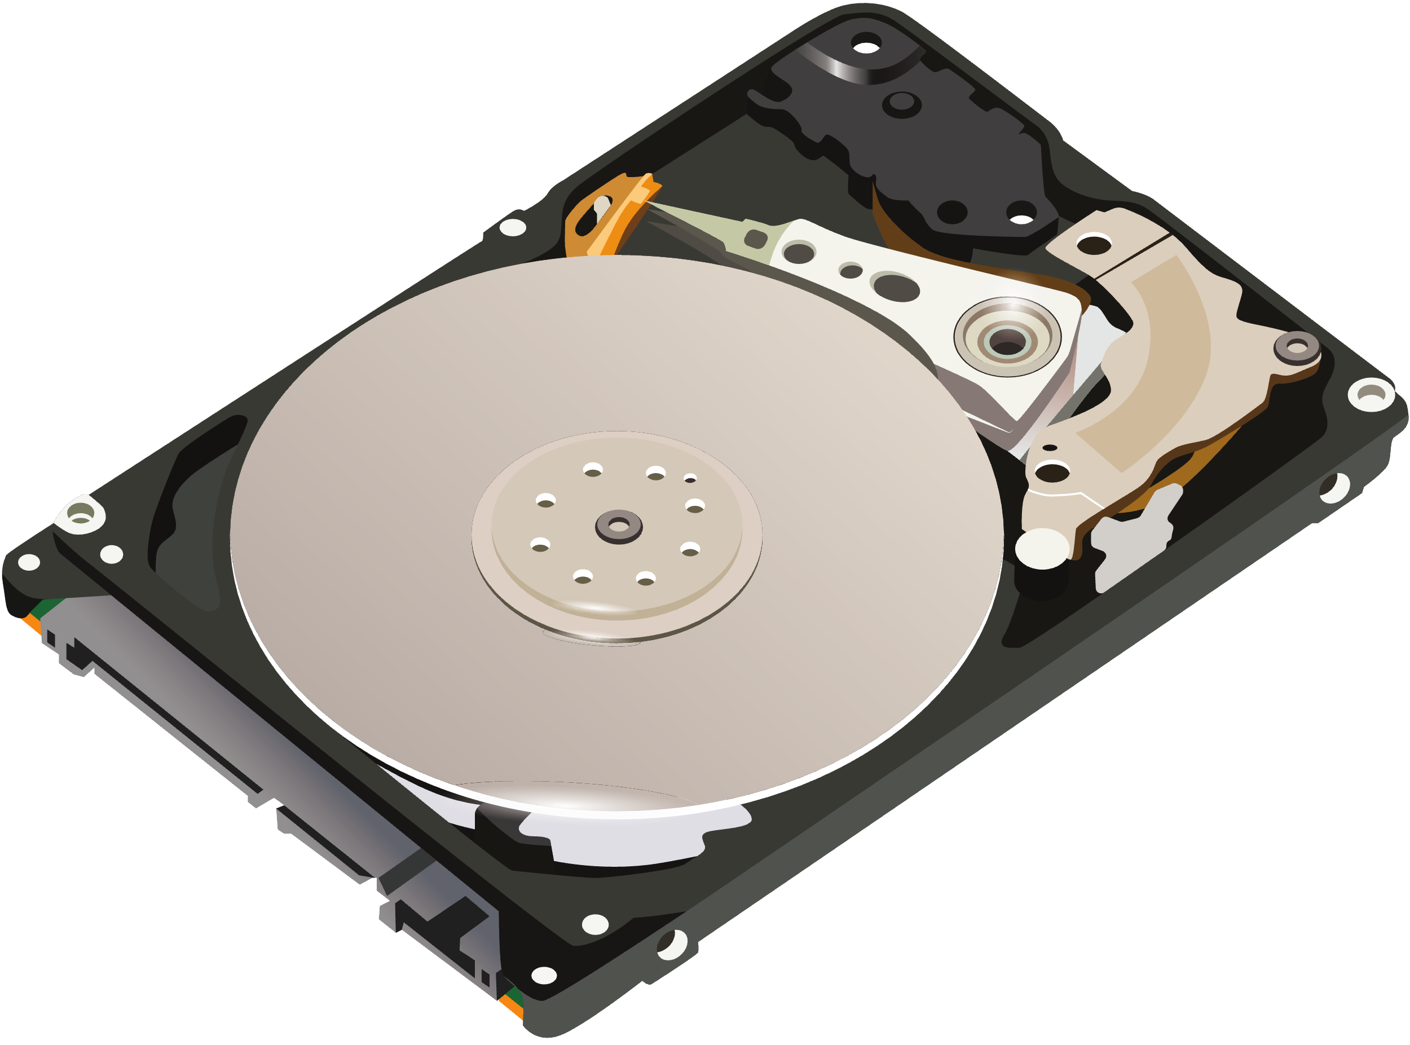
Examples of Internal Computer Hardwares:
Source: PC Components
RANDOM ACCESS MEMORY (RAM)
STORAGE DRIVES
Data and programs currently in use are held in the RAM. It is called random access because data can be accessed in any order. RAM is volatile, which means that the memory stored is temporary.
Storage Drives are devices that allows a computer to retrieve and store data within a computer system. Most common are Hard Drive Disks (HDD) and Solid State Drive (SSD).

Slide 10
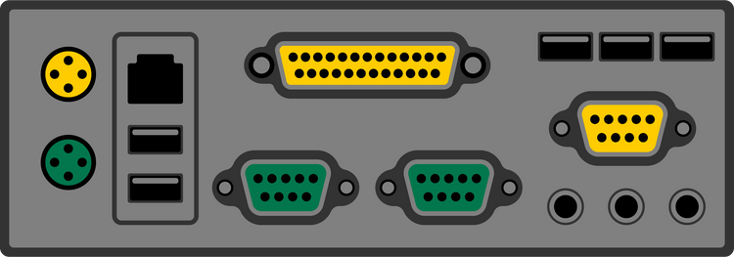
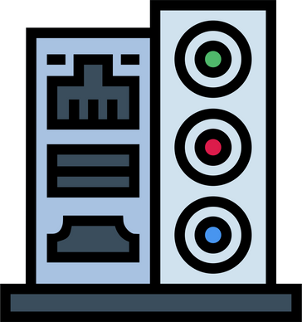

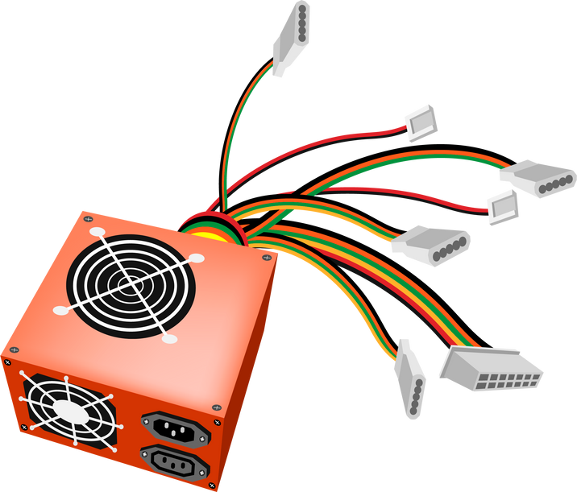
Examples of Internal Computer Hardwares:
Source: PC Components
PORTS
POWER SUPPLY UNIT
Computer ports are interfaces between peripheral devices and the computer system. They are hardware devices built into the motherboard. They are often built into the front of the computer chassis for easy access but will be cabled back to the motherboard.
Converts AC power from the wall sockets into DC. Must provide sufficient power for the installed components.

Slide 11

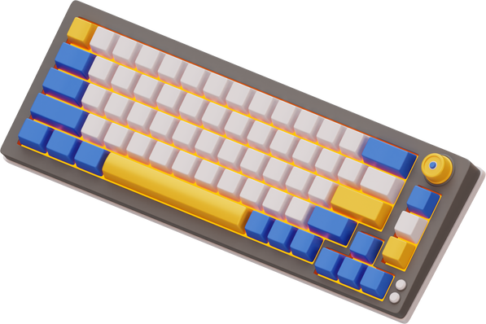

Common External Hardware Components (Inputs):
MOUSE
KEYBOARD
Source: Computer Hardware
MICROPHONE
A Mouse is a hand-held pointing device that moves a cursor around a computer screen and enables interaction with objects on the screen. It may be wired or wireless.
A Keyboard is a type of external computer hardware component that adds more buttons for shortcuts or text entry.
A Microphone is a device that translates sound waves into electrical signals and supports computer-based audio communications.

Slide 12


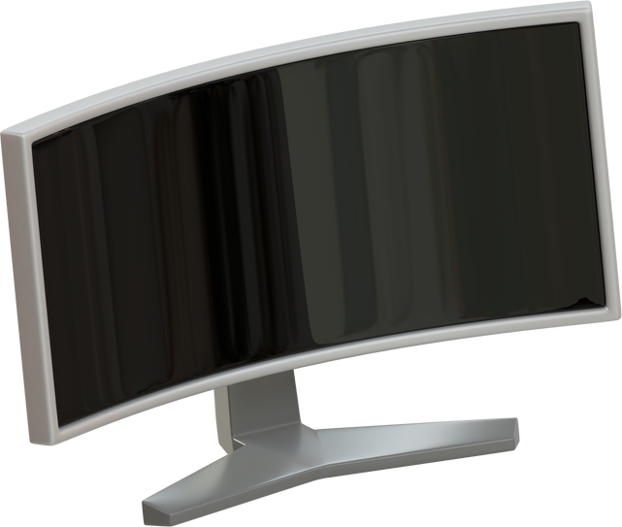
Common External Hardware Components (Outputs):
Source: Computer Hardware
SPEAKER
PRINTER
MONITOR
A Speaker is an external audio output device that connects to a computer to generate a sound output. This includes earphones and headsets.
Printers render electronic data from a computer into printed material.
A Monitor is an output device similar to a TV screen that displays information, documents or images generated by the computing device.

Slide 13
COMPUTER SOFTWARE
These are set of instructions that control the operation of the computer and its devices.
Software tells the computer what to do. It refers to the various computer programs that controls the way a computer operates.
A program is a set of instructions arranged in a logical way that a computer can run.
Source: Computer Software, Computer Software, Computer Software

Slide 14

Types of Computer Software:
SYSTEM SOFTWARE
APPLICATION SOFTWARE
This type of software that manages and operates computer hardware, providing a platform for other software. Examples include operating systems, device drivers, and utilities.
This type of software is designed to help users perform specific activities or solve particular problems. Examples include productivity tools, media players, and business applications.

Slide 15
Categories of System Software:
OPERATING SYSTEM (OS)
PROGRAMMING LANGUAGES
UTILITY PROGRAMS
Is a set of grammatical rules for instructing a computer to perform specific tasks.
It is what allows humans to communicate to computers to create programs.
Each programming language is used for different sets of tasks.
Provides basic working environment/user interface on a computer.
To control the use of peripherals.
To manage booting process of a computer.
To control loading and running of application programs.
Scan and fix computer viruses.
It detects and protects a computer against computer viruses.
Helps in file back up.
Diagnose computer problems.
Performs tasks on files.
Compress files of disks.

Slide 16
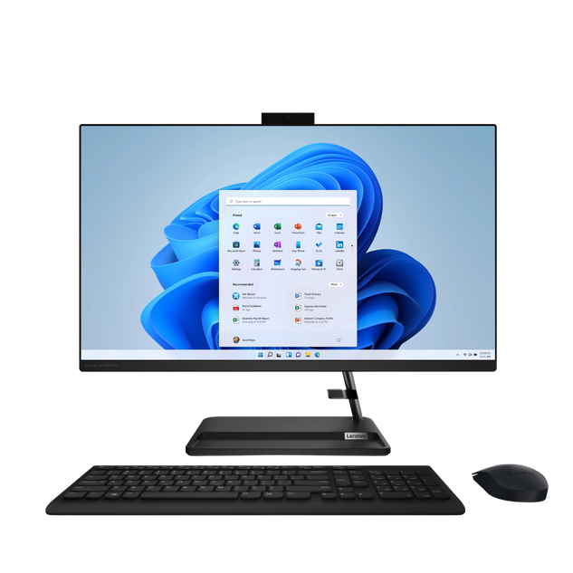
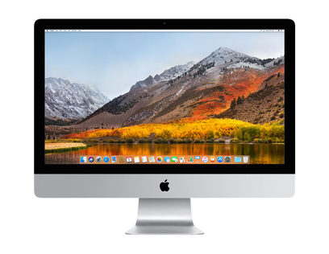
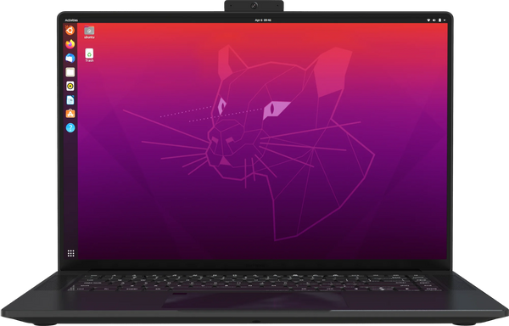
Examples of Common Operation Systems (OS):
WINDOWS
MACOS
LINUX
A widely used operating system developed by Microsoft, known for its user-friendly interface and compatibility with a large range of software applications. It’s commonly used in personal computers, business environments, and gaming.
An operating system created by Apple, specifically for Mac computers. It’s known for its sleek design, robust security, and seamless integration with Apple devices and services.
An open-source operating system known for its flexibility, security, and customization options. It’s popular among developers, IT professionals, and for use in servers and embedded systems.

Slide 17
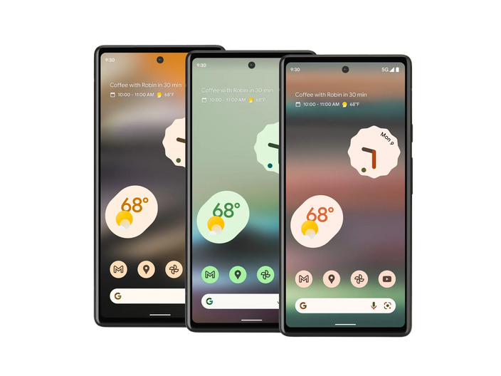
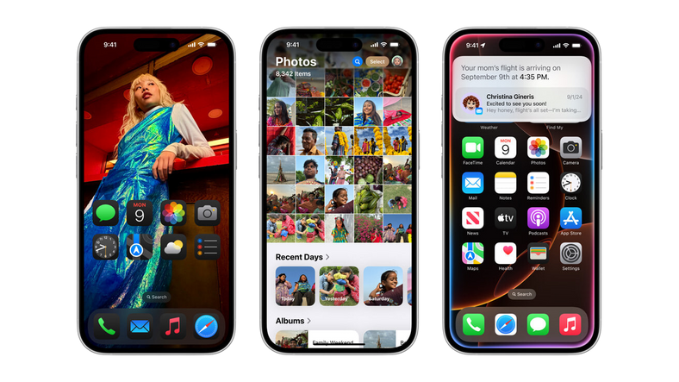
Examples of Common Operation Systems (OS):
ANDROID
IOS
A mobile operating system developed by Google, primarily used in smartphones, tablets, and other smart devices. It’s known for its wide app ecosystem and customizable user interface.
Apple’s mobile operating system for iPhone, iPad, and iPod Touch. It’s known for its security, efficiency, and tight integration with Apple’s hardware and ecosystem.

Slide 18




Examples of Common Programming Languages:
C & C++
FORTRAN
COBOL
C and C++ (pronounced “c plus plus”) are powerful, general-purpose languages developed at Bell Laboratories. The C language was created in 1972 and the C++ language was created in 1983
FORmula TRANslator was the first high-level programming language. It was designed in the 1950s for performing complex mathematical calculations.
Common Business-Oriented Language was created in the 1950s, and was designed for business applications.

Slide 19



Examples of Common Programming Languages:
PYTHON
C#
JAVA
Python is a general-purpose language created
in the early 1990s. It has become popular in business and academic applications
Pronounced “c sharp.” This language was created by Microsoft around the year 2000 for developing applications based on the Microsoft .NET platform.
Java was created by Sun Microsystems in the early 1990s. It can be used to develop programs that run on a single computer or over the Internet from a web server.

Slide 20



Examples of Common Programming Languages:
JAVASCRIPT
RUBY
PHP
JavaScript, created in the 1990s, can be used in web pages. Despite its name, JavaScript is not related to Java.
Ruby is a general-purpose language that was created in the 1990s. It is increasingly becoming a popular language for programs that run on web servers.
An open-source operating system known for its flexibility, security, and customization options. It’s popular among developers, IT professionals, and for use in servers and embedded systems.

Slide 21


Examples of Common Utility Softwares:
FILE MANAGER
PERSONAL FIREWALL
A File Manager is a utility that performs functions related to file management, such as displaying a list of files in folders, copying, renaming, deleting, moving, and sorting files or folders.
A Personal Firewall is a utility that detects and protects a personal computer from unauthorized intrusions, monitoring all transmissions to and from a computer.

Slide 22


Examples of Common Utility Softwares:
MEDIA PLAYER
ANTIVIRUS
A Media Player is a program that allows
you to view images and animation, listen
to audio, and watch video files.
An Antivirus Program protects a computer against viruses by identifying and removing any computer viruses found in memory, storage, or incoming files. Three popular Antivirus programs are: McAfee VirusScan, Norton AntiVirus, and SmadAV.

Slide 23






Examples of Common Application Softwares:
WORD PROCESSING SOFTWARE
SPREADSHEET SOFTWARE
PRESENTATION SOFTWARE
Word Processing Softwares aids users in creating business and personal documents, such as letters, reports, memos, and etc.
Popular Word Processing: Microsoft Word, Pages, Libre Oficce Writer.
Spreadsheet Softwares aids users in creating worksheets that perform calculations on financial and statistical data.
Popular SpreadSheet Softwares: Microsoft Excel, Numbers, LibreOfficer Calc.
Presentation Softwares aid users in creating graphical slides to support presentations.
Popular Presentation Softwares: Microsoft Powerpoint, Keynote, LibreOffice Impress.

Slide 24



Examples of Common Application Softwares:
DATABASE SOFTWARE
INTERNET BROWSERS
GAMING
Database Softwares is used for setting up or structuring databases.
Databases are used for storing different types of useful data/information.
Internet Browsers are used primarily for displaying and accessing websites on the Internet, as well as other content available in the internet.
Popular Internet Browsers: Google Chrome, Microsoft Edge, Mozilla Firefox.
Gaming Software refers to programs and applications designed to play interactive digital entertainment that involves gameplay through a user interface.
Popular Games: Dota, Minecraft, Fortnite, Valorant.

Slide 25


Implementation of Computers in the Community
Computers are awesome, but how are they used in the current age?

Slide 26

Implementation of Computers in the Community
Computer Hardware and Software play vital roles across different institutions and fields in the community due to their abilities in improving efficiency and ultimately enhancing the quality of service (Kejawa, 2016).

Slide 27




Education
Computers contribute greatly in the field of education in schools and universities by:
Allowing students to store and access lessons which enables them to review and revisit material when needed.
Allowing learners to efficiently access millions of information through the Internet.
The concept of smart classes and e-books are only possible because of computers.
Instructors and Teachers and aided by computers which allow them to efficiently complete tasks.

Slide 28

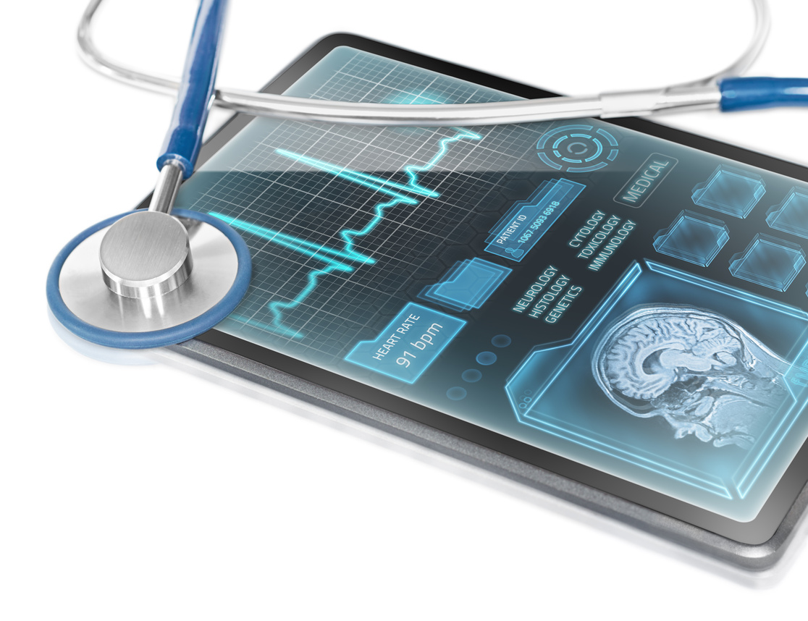
Healthcare
Computers contribute greatly in the field of medicine and healthcare in hospitals and medical facilities by:
Allowing patients to efficiently book appointments and allow the employees to make files for patients with ease.
The preservation of patient information allows medical practitioners to easily access patient’s file allowing them to efficiently track patient records and health development.
Allowing medical practitioners to efficiently complete tasks through advanced Diagnostic and Treatment Tools. Tools likes the MRI and CT scanners improve the accuracy and speed of diagnosis.

Slide 29


Entertainment
Computers contribute greatly in the industry of entertainment by:
Allowing users to easily play fun games, listen to music, and watch movies or videos with digital distributions platforms such as Netflix, Youtube, and Spotify.
The advancement of computers and technology has enabled modern entertainment products to maximize consumer experience.
Computers enable the development of social media platforms and interactive content, fostering communities and user-geneted entertainment.

Slide 30


Business
Computers contribute greatly the field and industry of businesses by:
Allowing mass production and automation by factories which heavily rely on computers to operate machines and equipment in order to ensure a high level of quality in production.
Computers allow fast calculations, data storage, and analysis, streamlining business operations. Software tools for data analysis and presentations enable businesses make informed decisions, track performance, and optimize processes.
Supporting companies through digital marketing which enables them to easily spread products and services to many users.

Slide 32
Analysis
Computers have revolutionize the daily lives of humans. From improving all processes of work in the field of business to improving the quality of education. Moreover, computers have also improved communication. Technology has been made simpler in daily life to solve complex tasks that will otherwise take more time to achieve. They also reduce the mistakes that humans commit while calculating ensuring that the solutions they provide are accurate and reliable most importantly in areas like health care and engineering. They also provide knowledge to a broad range of people for the purpose of learning, innovating, and thinking. Considering computers play a vital role in our lives, it is also important to study and learn how and why they work.

Slide 33
Analysis
Two important components of the computers are the hardware and the software. Hardware refers to the physical elements of a computer, among which are a processor, memory, and storage devices together working to process and store data. The processor is essentially the brain of a computer, carrying out the execution of instructions at incredibly high speeds. On the contrary, software refers to programs and applications that give out instructions to the hardware regarding what to do. The operating system is the most fundamental software layer: that is, either like Windows or macOS, it represents the core for managing resources on hardware while running other software. Applications enable users to perform a variety of tasks, from browsing the internet to efficiently complete tasks.

Slide 34
Analysis
In conclusion, computers have fundamentally changed the way we live, work, and connect. As technology continues to evolve, understanding how computers function and mastering their use becomes increasingly essential. Embracing this knowledge empowers us to harness their full potential in our personal and professional lives.

Slide 35
References
Al MUSTAQBAL UNIVERSITY. (n.d.). Computer Hardware. https://uomus.edu.iq/img/lectures21/MUCLecture_2022_910622.pdf
Allaurio. (2019, August 16). Types of application software. Scribd. https://www.scribd.com/document/422072689/Types-of-Application-Software
Basil. (2021, October 16). Internal and external components of computer. Scribd. https://www.scribd.com/document/532858539/Internal-Hardware
Bulman, G., & Farilie, R. (n.d.). Technology and Education: Computers, Software, and the Internet.
Dalida, R. (2017, August 6). Types of hardware and function. Scribd. https://www.scribd.com/document/355644135/Types-of-Hardware-and-Function

Slide 36
References
Englander, I. (2010). The architecture of computer hardware, system software, and networking: An information technology approach. Wiley.
Gill, S. (n.d.). Impacts of Computers on Today’s Society. In International Journal of Core Engineering and Management (IJCEM) (Vol. 2, Ser. 1). essay. Retrieved November 9, 2024, from https://ijcem.in/wp-content/uploads/2015/05/Impacts_of_Computers_on_Todays_Society.pdf.
Haidar, A. (n.d.). COMPUTERS IN OUR DAILY LIFE. In International Journal of Computer Science and Information Technology Research (Vol. 9, Ser. 2, pp. 11–17). essay. Retrieved November 9, 2024, from https://www.researchpublish.com/upload/book/paperpdf-1618660253.pdf.
Kejawa, I. (2016). Computer in Society: The World of Science and Technology.

Slide 37
References
Mohamed, M. S. (2023, November 29). Hardware book bti.pdf. SlideShare. https://www.slideshare.net/MohamoudSaedMohamed/hardware-book-btipdf#2
Mugivane, F. (2014). Introduction to Computer.
PC components. Hardware and Software. (n.d.). https://www.t4.ie/Resources/Resources by Topic/Core/Information & Communications Technology/Introduction to Computer Systems/PC Components.pdf
Pearson Higher Education. (n.d.). In Introduction to Computers and Programming. essay. Retrieved November 9, 2024, from https://www.pearsonhighered.com/assets/samplechapter/0/3/2/1/0321537114.pdf.

Slide 38
References
Semantic Scholar. (n.d.). Utility programs - semantic scholar. Utility Programs. https://pdfs.semanticscholar.org/1407/8f09e95bb6b198a2947677fac8128375406f.pdf
Shah, J. (2020, April 26). Application software notes. Scribd. https://www.scribd.com/document/458471950/APPLICATION-SOFTWARE-NOTES
Stjoseph-Naggalama. (n.d.). COMPUTER SOFTWARE. http://www.stjoseph-naggalama.sc.ug/web/Uploads/30042020121006PM_S5%20COMPUTER%20SOFTWARE%20NOTES.pdf
Tonny, O. (2019, August 8). Computer software. Scribd. https://www.scribd.com/document/421172701/Computer-Software

Slide 39
References
Varghese, D. (2020, November 20). Use of computers in hospital and community. Scribd. https://www.scribd.com/document/485092440/Use-of-Computers-in-Hospital-and-Community
Viva College School. (n.d.). Topic 3: Computer software. TOPIC 3: COMPUTER SOFTWARE. https://vivacollegeschool.com/wp-content/uploads/2020/04/TOPIC-3-COMPUTER-SOFTWARE-for-s.2.pdf
Wang, M. (2020, November 27). Topic D: Common uses of computers in society. Key Concepts of Computer Studies. https://opentextbc.ca/computerstudies/chapter/common-uses-of-computers-in-society/

Slide 40

CIS 1102N
Thank You!
GERI GIAN C. EPANTO
BSCS - 1 | GROUP 6

